Slide 1
KEYLOGGER
CAPSTONE PROJECT
Presented By:
Suvetha . E - Jeppiaar Institute of Technology- B.Tech -Artificial Intelligence and Data Science

Slide 2
OUTLINE
Problem Statement
Proposed System/Solution
System Development Approach
Algorithm & Deployment
Result (Output Image)
Conclusion
Future Scope
References

Slide 3
Problem Statement
Develop a keylogger application capable of silently recording keyboard inputs target system. The keylogger should operate discreetly, persistently,and securely,providing customizable options for configuration. The project aims to provide insights into user behaviour for legitimate purposes while ensuring adherence to legal an ethical guidelines.

Slide 4
Proposed Solution
The proposed solution involves developing a Python-based keylogger using libraries like pynput for keyboard monitoring. Utilising Tkinter for the graphical user interface, the application ensures steel operation, persistence across system reboots, unsecured storage of logged data. Customizable configuration options enable users to specify logging frequency, file location, and startup behavior facilitating flexible deployment and usage. Additionally, implementing error handling mechanisms enhances robustness unreliability in various operating environments hey.

Slide 5
System Approach
A system approach for a keylogger involves breaking down the functionality and components of the keylogger application into several interconnected parts.
Requirement Analysis
Design Phase
Implementation
Testing
Deployment
Monitoring and Maintenance
Ethical Considerations

Slide 6
ALGORITHM & DEPLOYMENT
Initialization: Initialize necessary variables and flags.
Event Handling:
on_press(key): Records pressed and held keys.
on_release(key): Records released keys and manages flag state.
Logging:
generate_text_log(key): Saves keystrokes in a text file.
generate_json_file(keys_used): Saves keystrokes in a JSON file.
Keylogger Control:
start_keylogger(): Initiates keylogging process.
stop_keylogger(): Stops keylogging.

Slide 7
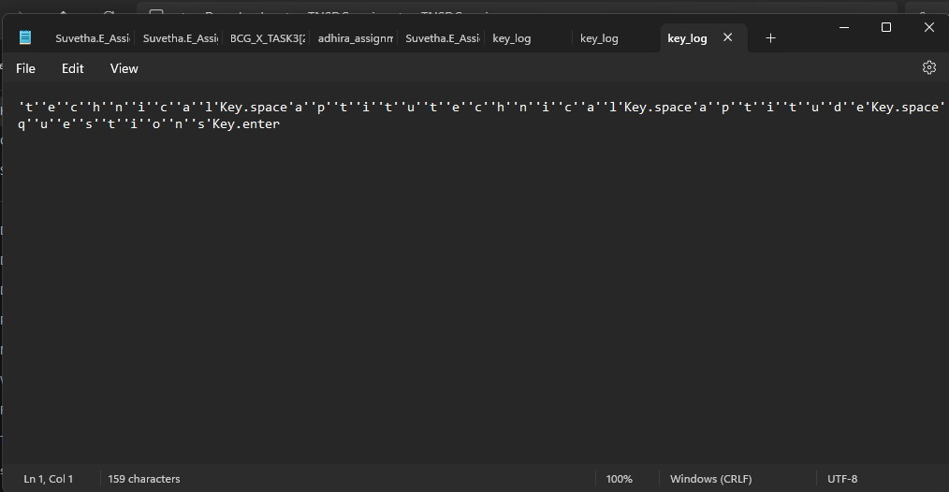
Result

Slide 8
conclusion
In conclusion, the developed keylogger application demonstrates effective functionality in discreetly capturing keyboard inputs, ensuring persistence, and providing configurable options for deployment. While offering valuable insights into user behavior for legitimate purposes, ethical considerations and compliance with legal regulations remain paramount for responsible deployment and usage. Moving forward, continued vigilance in monitoring and updating the application is essential to maintain its effectiveness and integrity.

Slide 9
Future scope
Future enhancements for the keylogger project could include incorporating machine learning algorithms to detect and classify user activities based on keystroke patterns. Integration with cloud services could enable real-time synchronization and analysis of logged data from multiple devices. Additionally, implementing encryption techniques for securing the stored data would enhance privacy and protection against unauthorized access. Furthermore, expanding compatibility to other input devices beyond keyboards, such as mouse movements or touch inputs, could broaden the application's monitoring capabilities.

Slide 10
References
- Python Software Foundation. (2022). Python Documentation. Retrieved from https://docs.python.org/3/
- pynput Documentation. (2022). Retrieved from https://pynput.readthedocs.io/en/latest/
- Tkinter Documentation. (2022). Retrieved from https://docs.python.org/3/library/tkinter.html

Slide 11
THANK YOU

